Slide 1

Contingent crop planning for aberrant weather conditions
Delivered by
Mr. Anil Swami
Asst. Professor
Rainfed Agriculture & Watershed Management Mr. Anil Swami

Slide 2
Objective:-
Tell the soil and climatic conditions prevalent in rainfed areas.
Interpret various water harvesting techniques and their efficient utilization.
Apply contingent crop planning for aberrant weather conditions.
Examine the seasonal rainfall and different types of watershed and its components.
Select soil and water conservation techniques to avoid their losses.

Slide 3
Contingent crop planning for aberrant weather conditions
Rainfall behavior in dry farming areas is erratic and uncertain.
The deviations in rainfall behavior include delayed onset, early withdrawal and intermediary dry spells during rainy season.
The adverse effect of these rainfall aberrations on crop growth vary with the degree of deviation and the crop growth stage at which such deviations occur.

Slide 4
Suitable manipulations in crop management practices are needed to minimize such adverse effects of abnormal rainfall behavior.
These management decisions constitute contingency planning.
Such management practices done after crop establishment and in the middle of growth are called midseason or midterm corrections.

Slide 5
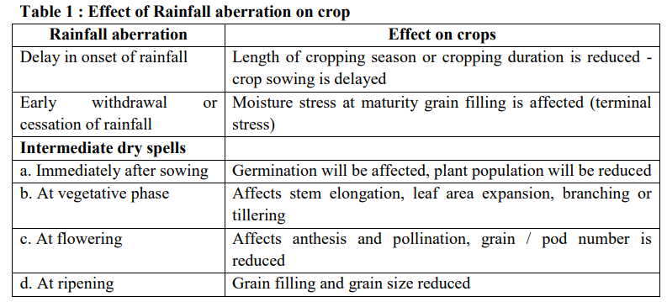

Slide 6
CONTINGENCY CROPPING
Contingency cropping is growing of a suitable crop in place of normally sown highly profitable crop of the region due to aberrant weather conditions.
In dryland agriculture, contingency of growing another crop in place of normally grown crop arises due to delay in the onset of monsoon.
Depending upon the date of receipt of rainfall, crops are selected.

Slide 7
It is assumed that the rainfall for the subsequent period is normal and depending upon the economic status of the farmer, certain amount of risk is taken to get good profits if season is normal or better than normal.
Contingency cropping is highly location specific due to variation in amount and distribution of rainfall.
Especially in arid regions, the spatial distribution of rainfall is highly variable.
It is common to observe that rainfall received varies from field to field in the same location.
Temperature gradually falls from August onwards reaching minimum in November and December.

Slide 8
Contingency plan and midterm corrections vary with the type and time of occurrence of rainfall aberration.
Crops have to be selected with suitable crop duration to coincide with the length of the growing season.
Generally short duration pulses like greengram, black gram and cowpea may suit the situation.
However if the monsoon turns to be extraordinarily good, opportunity is lost if only short duration crops are sown.

Slide 9
Farmers with economic strength and motivation for high profits with some amount of risk can go for crops of long duration.
The long duration crops with flexibility or elasticity in yield are more suitable.
For example, pearl millet, and sorghum can be ratooned if monsoon extends.
Sunflower can be introduced for higher profits with certain amount of risk.
Crops like sorghum, pearl millet, can be grown for grain if monsoon extends and if not, fodder can be obtained.

Slide 10
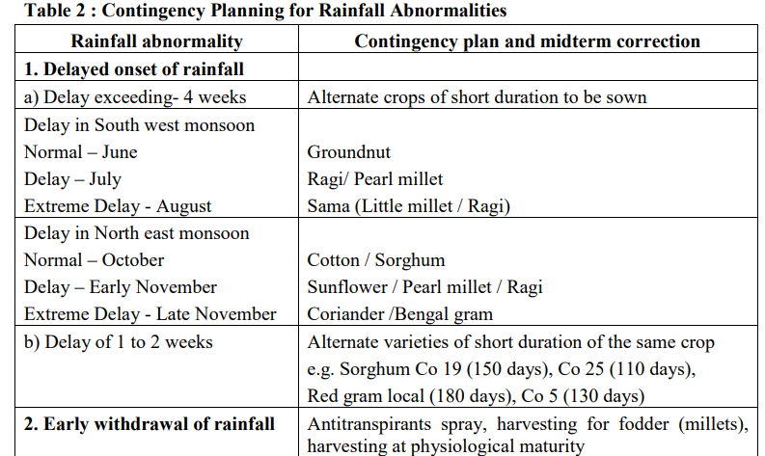

Slide 11
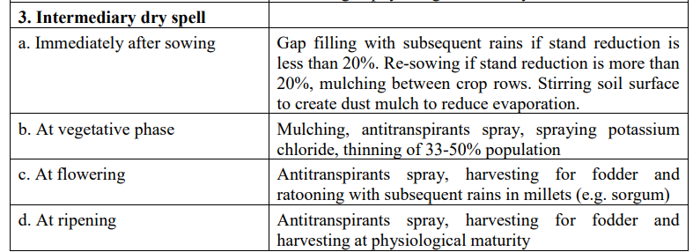

Slide 12
Crop planning for successful crop production under water scarcity and dry farming condition:
In low rainfall and water scarcity situations during kharif, the crops like Bajra, Castor and legumes crop like Tur, Moong, Black gram, Kidney bean, Guar and Cowpea.

Slide 13
Crop planning for successful crop production under water scarcity and dry farming condition should be as under:
1. Bunding and leveling should be done to conserve the rain water in situ.
2. Sowing the crop at optimum time.
3. Tillage and sowing of the crop across the slope.
4. Use higher amount of organic manures like FYM, compost, vermicompost and cake.

Slide 14
5. Apply fertilizers at sowing under adequate soil moisture or as top dressing after irrigation.
6. Use drip irrigation in wide spaced crops and sprinkler irrigation in narrow spaced crops, if possible.
7. Inter culturing, weeding and crop protection measures should be done as and when required.
8. Adopt mixed and inter cropping systems.
9. Raise crop in strip cropping.
10. Create farm pond for life saving irrigation.

Slide 15
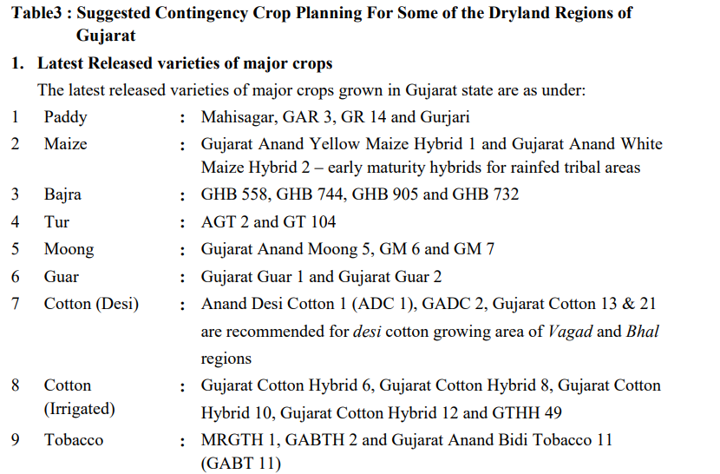

Slide 16
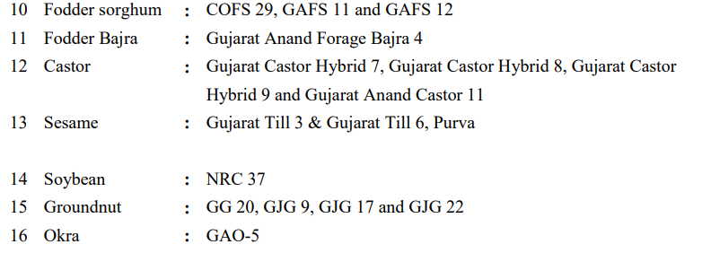

Slide 17
3. Recommendation for late onset of monsoon
Generally, the period between 15th June to 15th September is considered as kharif season.
However, it is required to change the crop planning in kharif season, if the rainfall pattern is found uneven.
If there is a late onset of monsoon, then select the crops and their verities as under:

Slide 18
Onset of monsoon in the first week of July- Groundnut varieties Gujarat Groundnut 2, Gujarat Groundnut 5 and Gujarat Groundnut 7 as well as cowpea variety Gujarat 1should be grown.
2. If sufficient rainfall occurs during first fortnight of July - Crops like bajra, moong, black gram, sesame, castor and tur should be grown.
3. If sufficient rainfall occurs at the end of July – Sesame (Purva 1) and forage sorghum variety Gundari should be grown.

Slide 19
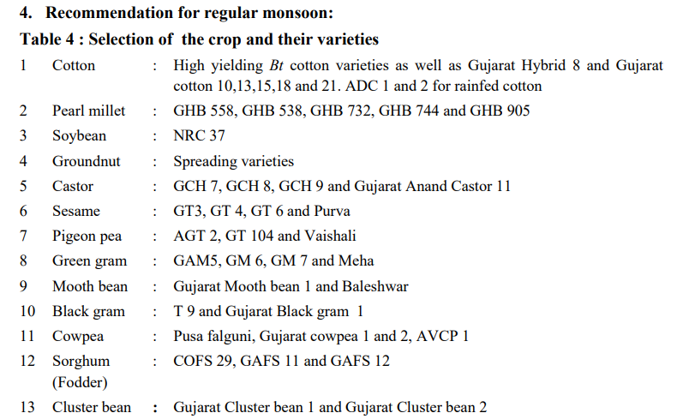

Slide 20
5. Recommendations under long dry spell
There is a shortage of moisture in the soil, if the duration between two rainfall is extended even under normal on set on monsoon.
If this period between rainfall is extended for longer time, than there is a partial or full failure of the crop.

Slide 21
Under this situation crop planning should be done as under
1. Do interculturing and weeding. Keep crop weed free and do mulching.
2. When moisture stress prevails, thinning should be done. If more moisture stress prevails, remove alternate row and thin the plant in the field
3. Provide lifesaving irrigation to the crop if irrigation facility available
4. When sufficient rainfall received after dry spell, nitrogen fertilizer should be given as top dress to the crops except groundnut.

Slide 22
5. When crop failed due to long dry spell, after receiving sufficient
rainfall farmers can grow hybrid pearl millet GHB 558, GHB 577.
6. Farmers should grow Sesame variety Purva 1 or Gujarat Til 1 or Castor variety GAUCH 1 and GAC 11. In addition farmers can also grow fodder sorghum or rajaka bajri.
7. Reduce the plants by harvesting the matured plants frequently, to save the conserved

Slide 23
6. Recommendations when heavy rainfall occurs at the end of monsoon during August – September Many times during end of September or beginning of October late rainfall received.
Under such situation following crop planning can be done.
For getting the benefits of good late rainfall sowing of fodder sorghum, short duration semi rabi and rabi crops i.e. castor, mustard, gram, safflower, fodder crops (maize/oat and lucerne) should be grown as relay crops between two rows of long duration crops i.e. cotton, tur and fennel.
Gram, mustard and fodder sorghum can be grown after harvesting of early maturing Kharif crops.

Slide 24
Thank You
Rainfed Agriculture & Watershed Management Mr. Anil Swami

