Slide 1
Course Name: Fundamentals of Plant Pathology
Course Code: 20013600
Mr. Vikash Kumar
(Assistant Professor)

Slide 2
Course Objectives
1: Name and identify different Diseases, nature of pathogens and different strategies for management of plant diseases.
2: Outline concepts, nomenclature, classification and characters of pathogens
3: Apply different principles and methods for plant disease management.
4: Take a part in identification of diseases and marketing of relevant pesticides.
5: Conclude methods to diagnose and manage a wide range of plant diseases.

Slide 3
Viruses: nature, structure and transmission

Slide 4
➢ Adolf Mayer described a disease of tobacco called mosaic kranheit (tobacco mosaic).
➢ Iwanowaski – Filtrate TMV infected leaf juice extract from bacterial retaining filter.
➢ M.W. Beijerinck - He believed it to be contagium vivum fluidum (infectious living fluid). He was the first to use the term virus, which is the Latin word means poison. Also called father of plant virology.
➢ Crystallization of virus done by W. M. Stanley (1935) proved that viruses can be made as crystals. He got Nobel Prize in 1946.

Slide 5
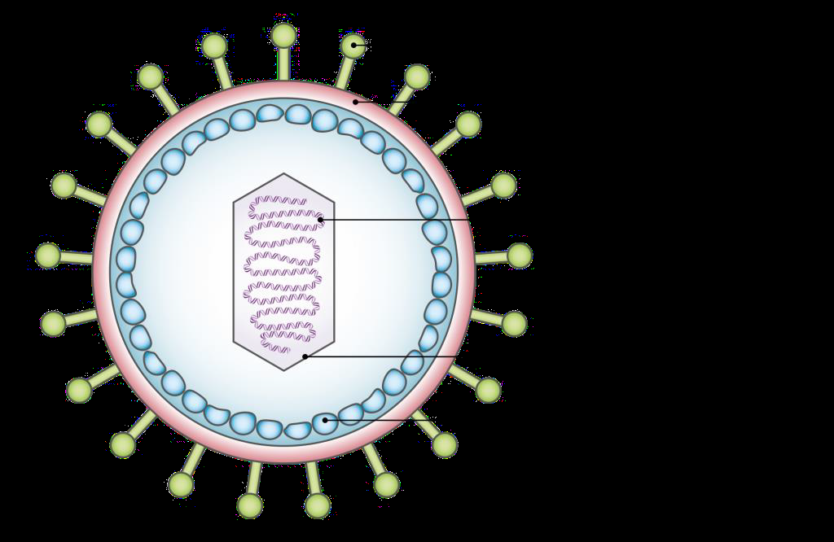
VIRUSES
They are infections agents made up of one type of nucleic acid (RNA or DNA) enclosed in a protein coat. Examples of viral diseases of plants are: potato leaf roll, leaf curl of tomato and chillies, and mosaic disease of many plants.
Virus: vira (poison fluid) sanskrit - visha (poison) sub microscopic, infectious entities, multiply intracellularly, potentially pathogenic.
Plant Virology : study of plant viruses

Slide 6
IMPORTANT CHARACTERISTICS OF PLANT VIRUSES:
• Ultra microscopic
• Pass through bacterial proof filters hence called filterable agents
• Obligate Parasites, highly infectious and host specific
• Movement of virus in cell through plasmodesmata.
• Dependent on host protein synthesizing machinery for replication and multiplication.
• Virions – technical name of virus/virus particle
• Virion consist of nucleic acid protected by protein coat (capsid) i.e., chemically nucleoproteins
• Genome: Majority - RNA Eg. Tobamo virus (Tobacco mosaic virus)
• Few - DNA Eg. Caulimovirus (cauliflower mosaic virus)

Slide 7
Shape of viruses
1. Rod (end open)
a. Rigid rod eg.TMV
b. Flexible rod eg. Potato virus-X (Potex)
2. Polyhedral virus (spherical/icosahedron)
Eg. Tobacco necrosis & Cucumber mosaic virus
3. Bacilliform (end covered by protein sub units)
Eg. Alfalfa mosaic virus
4. Gemini virus – Leaf curl virus, maize streak virus
Structure of Tobacco mosaic virus
Tobacco mosaic virus (TMV) is a plant virus that belongs to the genus Tobamovirus. The infection creates a mosaic like pattern, mottling and discoloration of the leaves.

Slide 8
Structure
• The tobacco mosaic virus (TMV) has a rod-like appearance that is 300 nm long with a diameter of 18 nm.
• It is covered by a protein shell called capsid that encloses the virus’s genetic material.
• The genetic material is a single-stranded RNA molecule.
• The capsid is made up of 2130 molecules of coat proteins that assemble in a rod-like helical structure possessing 16.3 proteins per helix turn.
The RNA is found in a coiled manner inside the capsid coat and is made up of approximately 6395 nucleotides.
Below is a simple and labelled diagram of TMV for your better understanding.

Slide 9
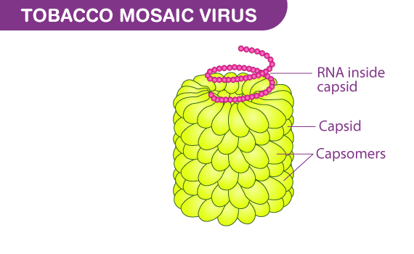

Slide 10
METHODS OF TRANSMISSION OF PLANT VIRUSES:
(A) Artificial transmission
1. Mechanically through Sap: Rubbing the sap from infected leaves to healthy leave Eg. Tobacco and tomato mosaic virus
2. Grafting: Grafting of plants from infected to healthy. Eg. Citrus tristeza, Tobacco leaf curl
(B) Natural transmission
1. Contact: physical/aerial contact of leaves Eg. TMV, PV-X
2. Seed/ propagative material:
a. Internal seed borne viruses - Eg. Bean, cowpea, soybean mosaic virus
b. Vegitatively propagating material - Eg. Sugarcane mosaic virus – setts PV-X –tubers

Slide 11
3. Phanerogamic parasites – virus transfer between unrelated hosts Eg. Dodder, Cuscuta campestris – Tomato bushy stunt virus
4. Soil: Virus viable for 6 years in soil Eg. Wheat mosaic virus
5. Fungi - Eg. Synchytrium endobioticum – PV-X, Olpidium brassicae- Tobacco necrosis virus 6. Nematodes - NEPO viruses (Nematode transmitted polyhedral viruses)
Eg. Xiphinema index- Grape fan leaf virus
Longidorus attenuatus - Tomato black ring virus

Slide 12
NETU viruses (Nematode transmitted Tubular viruses)
Eg. Trichodorus cylindricus - Tobacco rattle virus
7. Insect vectors: Most potential vectors
Vector– Any living organism that transmits a parasite is called vector.
Insects with sucking mouth parts more efficient than biting and chewing mouth parts.
Eg. Onion yellow dwarf virus by more than 50 species of aphids
Eg: Myzus persicae (aphid) transmits more than 50 viruses

Slide 13
DISEASE/ VIRUS INSECT
1. Rice tungro/ waika virus - Nephotettix apicalis (leaf hopper )
2. Redgram sterility mosaic-Aceria cajani (mite)
3. Tomato &tobacco leaf curl- Bemisia tabaci (white fly)
4. Yellow mosaic of pulses Bemisia tabaci
5. Bunchy top of banana- Pentalonia nigronervosa (aphid)
6. Bhendi yellow vein mosaic-Bemisia tabaci
7. Tomato spotted wilt virus-Thrips tabaci (thrips)
8. Potato leaf roll- Myzus persicae ( aphid )

Slide 14
Thank You

